Slide 1
ADO.NET: The connected layer
Ronnie Holm
Lecture 7

Slide 2
Agenda
Introduction to ADO.NET
ADO.NET data provider factory model
ADO.NET without provider factory
Application configuration file
The rest of ADO.NET
Repository and data mapper pattern

Slide 3
Introduction to ADO.NET
Connected layer of ADO.NET is for accessing a live database
ADO.NET is the lowest level data access component in the .NET framework
LINQ-to-SQL and LINQ-to-Entities build upon ADO.NET
ADO.NET supports multiple data providers, each optimized to interact with a specific RDBMS

Slide 4
ADO.NET data provider factory model
Factory pattern allows you to build a single code base using generalized data access types
IDbCommand
IDbConnection
IEnumerable
IDataRecord
IDataReader
DbDataReader
DbCommand
DbConnection
SqlCommand
SqlConnection
SqlDataReader
Notes:
- Obtain providers and connection strings declaratively, without the need to recompile/redeploy assembly

Slide 5
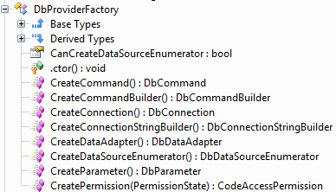
ADO.NET data provider factory model (2)
DbProviderFactory
OleDbFactory
SqlClientFactory
OdbcFactory
class Program {
static void Main(string[] args) {
// read type of factory from app.config
DbProviderFactory factory =
DbProviderFactories.GetFactory("System.Data.SqlClient");
// actually returns provider-specific class, i.e., SqlConnection
DbConnection connection = factory.CreateConnection();
}
}
Notes:
- Now you can switch the type of database without modifying the application - As long as you stick to the general Db* objects returned by the factory - As long as the SQL statements are compliant - Like switching programming language. Not very realistic - Adds a lot of complexity for no apparent value

Slide 6
ADO.NET data provider factory model (3)
class Program {
static void Main(string[] args) {
DbProviderFactory factory =
DbProviderFactories.GetFactory(
ConfigurationManager.AppSettings["provider"]);
using (DbConnection con = factory.CreateConnection()) {
con.ConnectionString = ConfigurationManager.
ConnectionStrings["AutoLot"].
ConnectionString;
con.Open();
DbCommand cmd = factory.CreateCommand();
cmd.CommandText = "select * from inventory";
cmd.Connection = con;
using (DbDataReader dr = cmd.ExecuteReader()) {
while (dr.Read()) {
Console.WriteLine(dr["CarID"] + " " + dr["Make"]);
}
}
}
}
}

Slide 7
ADO.NET without provider factory
class Program {
static void Main(string[] args) {
string conString = ConfigurationManager.
ConnectionStrings["AutoLot"].ConnectionString;
using (SqlConnection con = new SqlConnection(conString)) {
con.Open();
SqlCommand cmd = con.CreateCommand();
cmd.CommandText = "select * from inventory";
using (SqlDataReader dr = cmd.ExecuteReader()) {
while (dr.Read()) {
Console.WriteLine(dr["CarID"] + " " + dr["Make"]);
}
}
}
}
}

Slide 8
Application configuration file
Non-web apps have an app.config, web apps have a web.config
<?xml version="1.0" encoding="utf-8" ?>
<configuration>
<appSettings>
<add key="provider" value="System.Data.SqlClient" />
</appSettings>
<connectionStrings>
<add name ="AutoLot" connectionString =
"Data Source=(local)\SQLEXPRESS;
Integrated Security=SSPI;Initial Catalog=AutoLot"/>
</connectionStrings>
</configuration>
Notes:
- SSPI is set to true which uses current account Windows account credentials for user authentication

Slide 9
The rest of ADO.NET
To execute insert, update, or delete statements and for creating tables and so on, call SqlCommand.ExecuteNonQuery()
Call SqlCommand.ExecuteScalar() for obtaining record count, min, and max values
Parameterize query to prevent SQL injections
Notes:
- ExecuteNonQuery returns number of modified rows

Slide 10
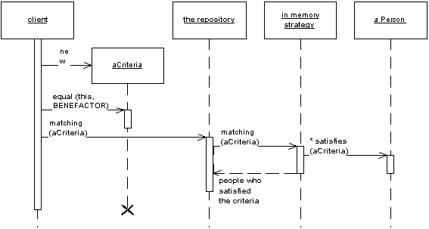
Repository pattern
Mediates between domain and data mapping layers using a collection-like interface for accessing domain objects
Notes:
- Acts like an in-memory domain object collection - Isolates domain objects from details of database access code - It can be worthwhile to build another layer of abstraction over the mapping layer, where query construction code is concentrated - Adding this layer helps minimize duplicate query logic - Client objects construct query specifications declaratively and submit them to Repository for satisfaction - Provides a more object-oriented view of persistence layer

Slide 11
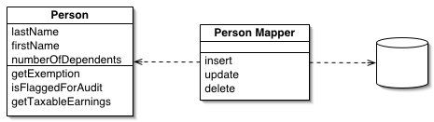
Data mapper pattern
Layer of mappers that moves data between objects and database while keeping the two independent of each other and the mapper itself
Objects and relational databases have different mechanisms for structuring data
Notes:
- Many parts of an object, such as collections and inheritance, aren't present in relational databases - Impedance mismatch - The object schema and the relational schema don't match up - Need to transfer data between the two schemas, and this data transfer becomes a complexity in its own right - If the in-memory objects know about the relational database structure, changes in one tend to ripple to the other - Separates the in-memory objects from the database - Transfer data between the two and also to isolate them from each other

Slide 12
Light-weight ORM
https://github.com/robconery/massive
Rob Conery: Kill your ORM talk http://ndc2011.no/agenda.aspx?cat=1071&id=-1&day=3727
Compare light-weight ORM to open source drop of Entity Framework
http://entityframework.codeplex.com/
Notes:
- Attempts at solving the impedance mismatch problem - RDBMS typically doesn’t support OO inheritance very well - OO databases was widespread in the 80s but never took off - Maybe even use a nosql datababase

